Slide 1

Modeling U.S. Inflation
Presented by Benjamin Allen
ben.allen@rice.edu
STAT410 Final Project

Slide 2

Agenda
Introduction
Project Overview
Initial Insights
Linear Model
Time Series Models
Conclusions
Q&A

Slide 3
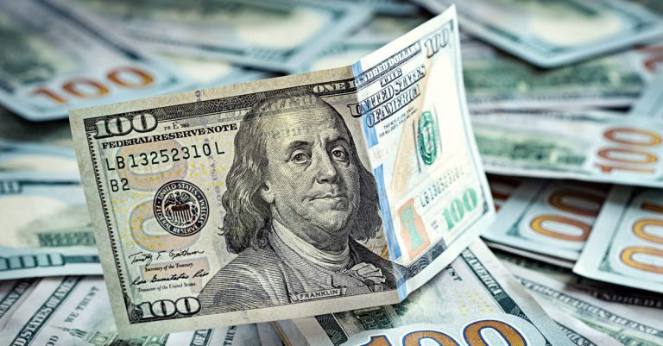
What’s new with inflation?
In recent months, Inflation has been everywhere in the news
COVID-19 and subsequent lockdowns led to disinflation
Government responded with immense economic aid
Economic recovery was swift, at the cost of volatile inflation
Inflation is a general increase in prices in the economy
High inflation harms consumers and reduces standard of living

Slide 4
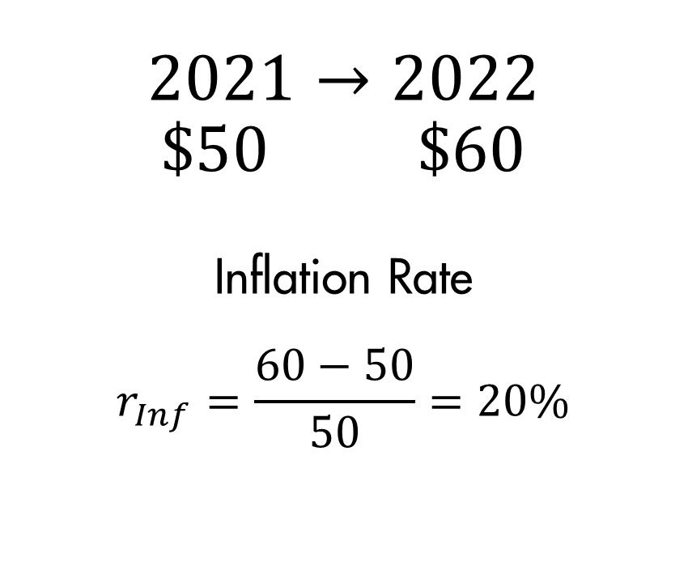
Project Overview
$$2021→2022$$
$$\$50 \$60$$
Inflation Rate
$$r_{Inf}=\frac{60−50}{50}=20\%$$
For this project we will model the inflation rate for all goods
Inflation is measured as the percent change of prices from a year ago versus now
Main Goal: Create a model able to forecast inflation a year in advance

Slide 5
Project Data
Sourced from U.S. Bureau of Labor Statistics (bls.gov):
Inflation Rate for All Goods
Monthly Unemployment Rate
WTI Crude Oil Price Index
All Commodities Price Index
Sourced from St. Louis Federal Reserve (fred.stlouisfed.org)
Federal Funds Rate
M2 Monthly Money Supply
Consumer Sentiment Index (University of Michigan)
Notes:
Unemployment because of Phillips Curve relationship

Slide 6
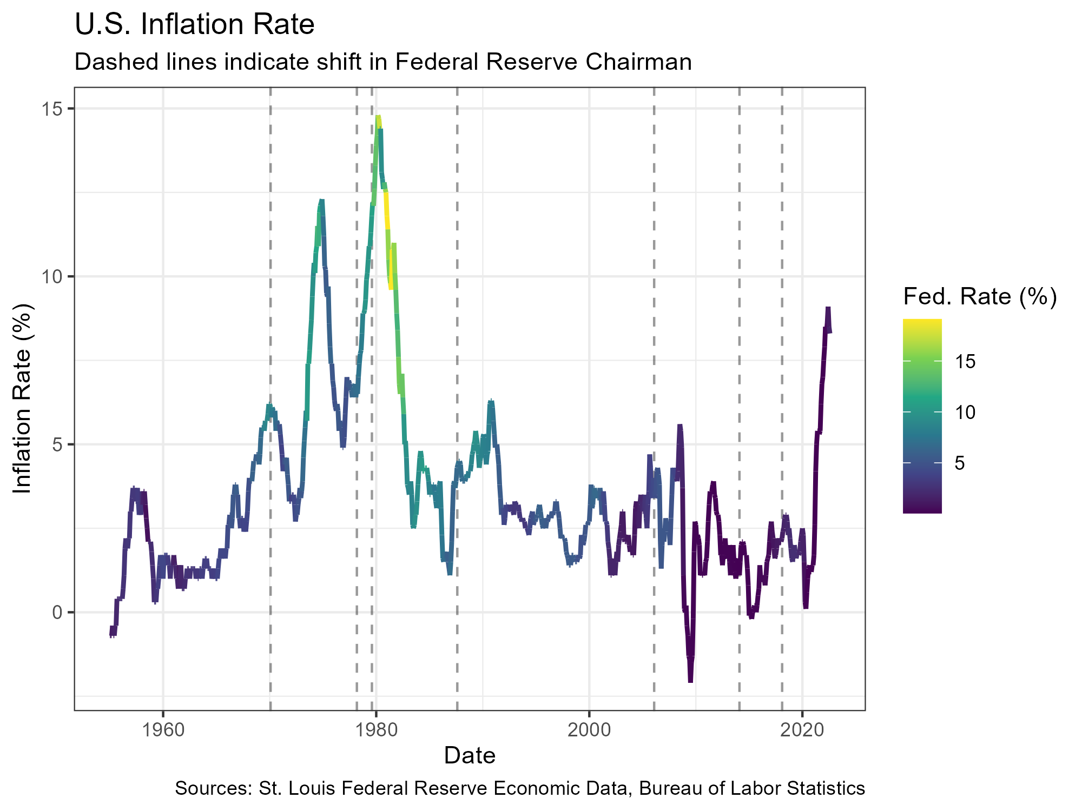
How has inflation changed over time?
Stable inflation is a recent trend
The 70s saw high inflation due to large increases in the money supply and an oil embargo
Brief deflationary period during the Great Recession

Slide 7
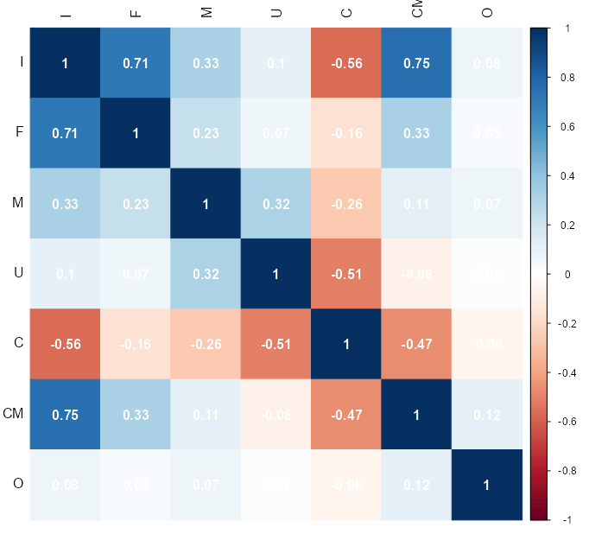
What is related to inflation?
Federal funds rate and commodity prices are highly positively correlated
Consumer sentiment is moderately negatively correlated
Federal funds and commodity prices uniquely related to inflation

Slide 8
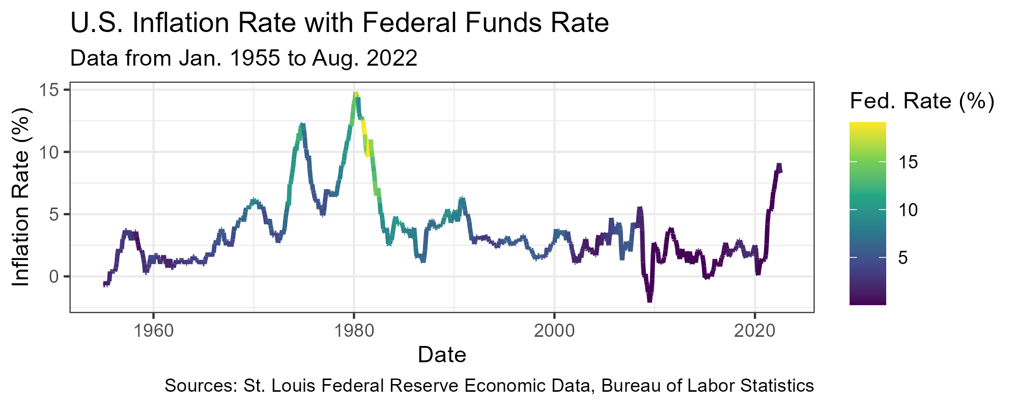
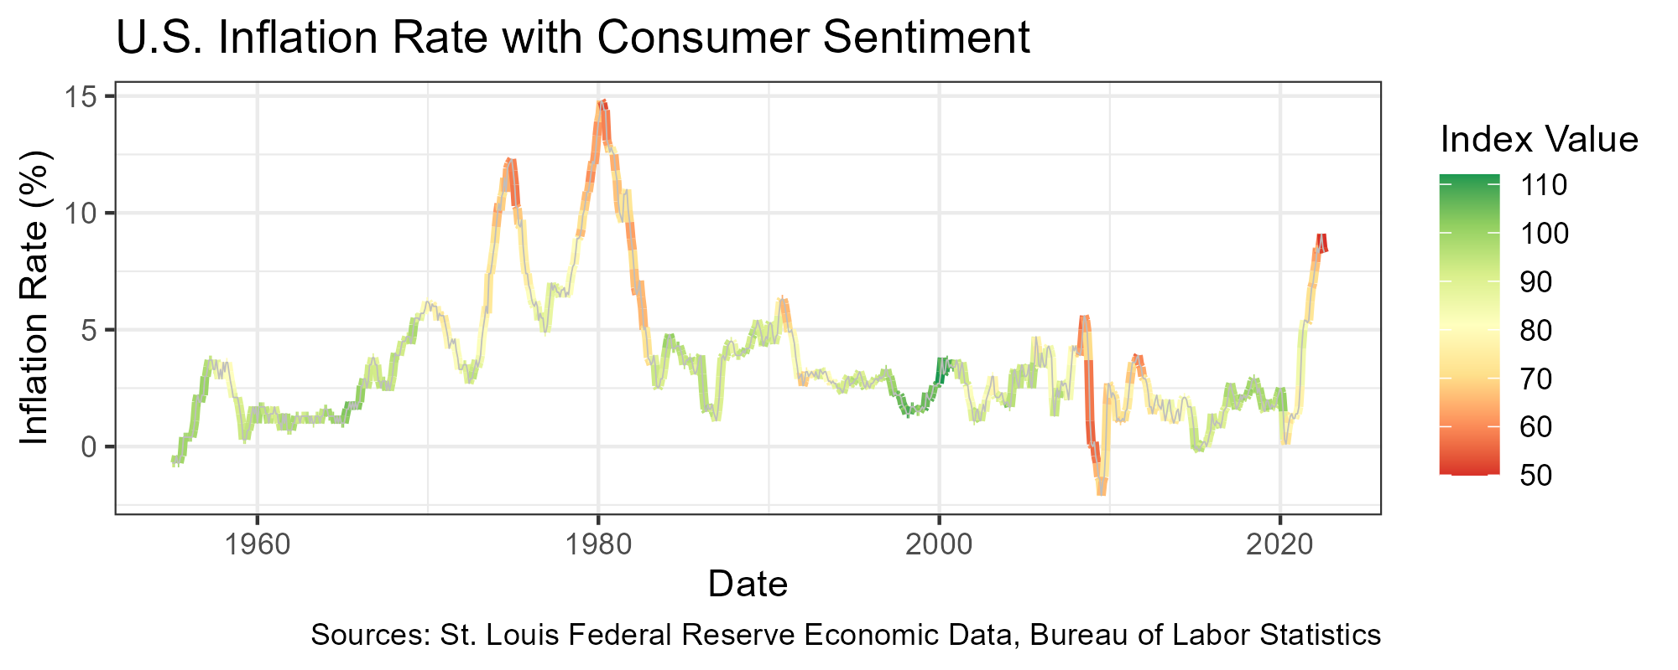
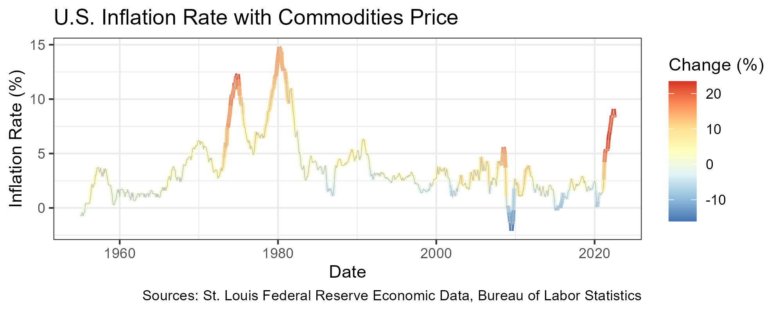
What is related to inflation?
Federal funds is lower nowadays, but still rises with inflation
Consumer sentiment seems to drop because of volatile inflation
Commodity prices and inflation rise and drop together

Slide 9
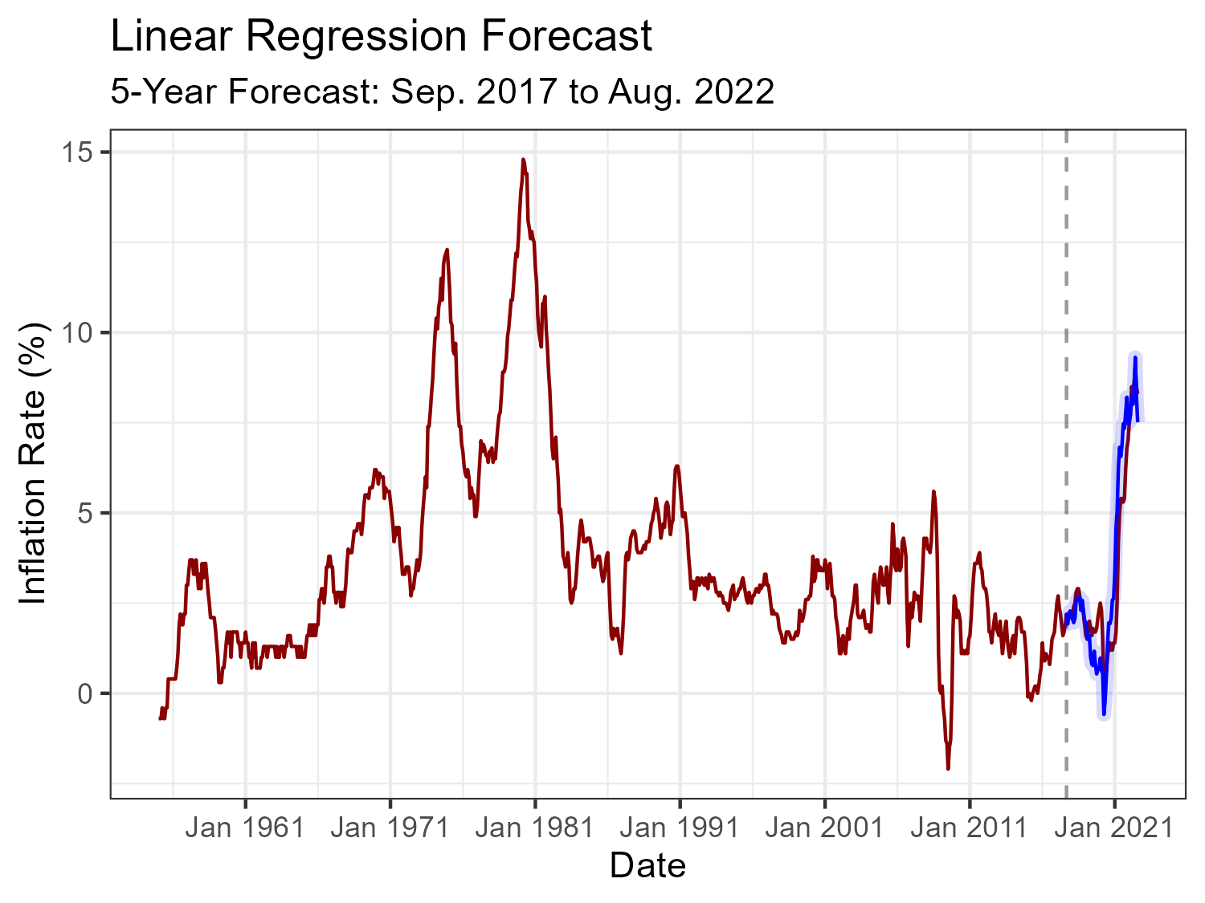
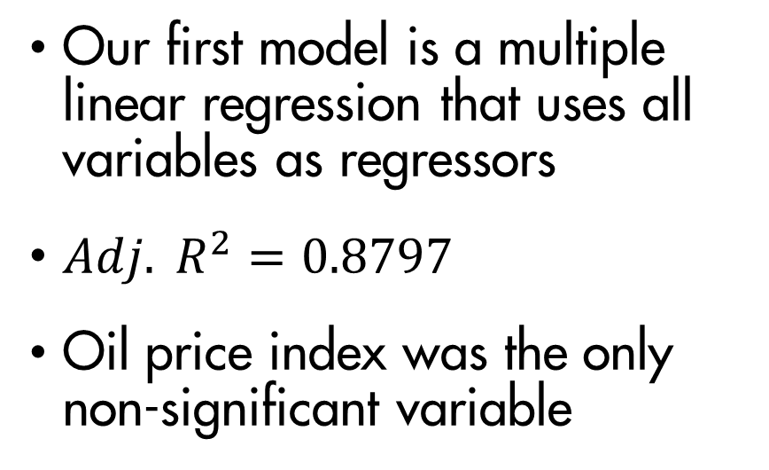
Setting up Linear Model
Our first model is a multiple linear regression that uses all variables as regressors
${Adj. R}^{2}=0.8797$
Oil price index was the only non-significant variable
Notes:
Mention stepwise regression did not improve performance much

Slide 10
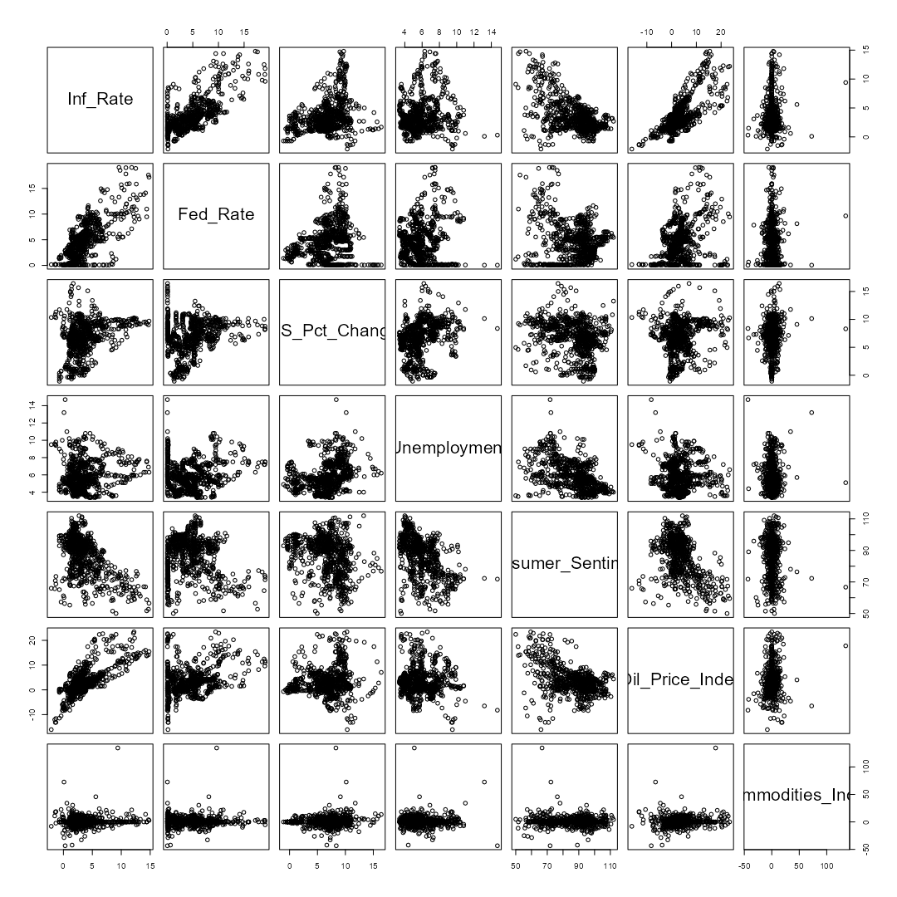
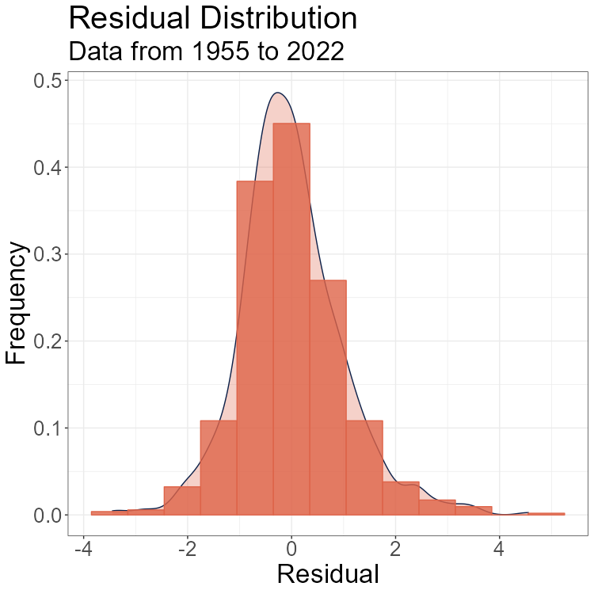
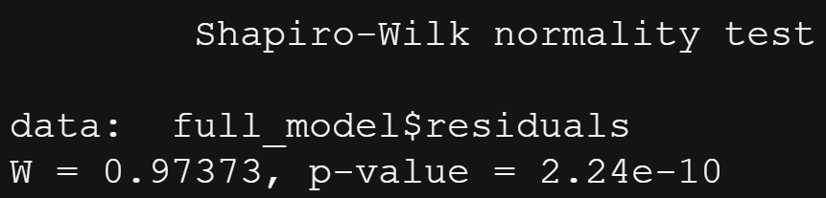
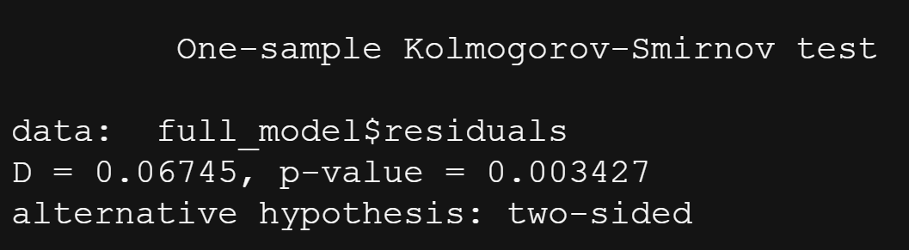
Evaluating the Linear Model
Linearity?
Potentially true for federal funds rate (1), consumer sentiment (4), and commodity prices (5)
The rest do not appear linear
Normal Errors?
Histogram shows slight positive skew in residuals
Shapiro and Kolmogorov-Smirnov test both rejected
(1) (2) (3) (4) (5) (6)

Slide 11
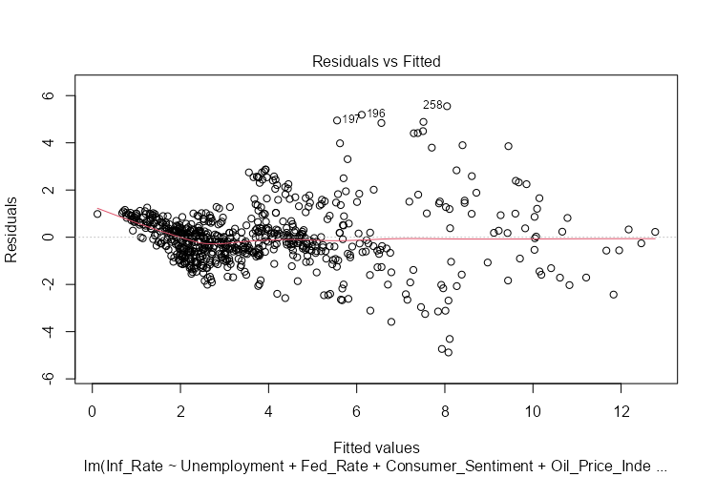
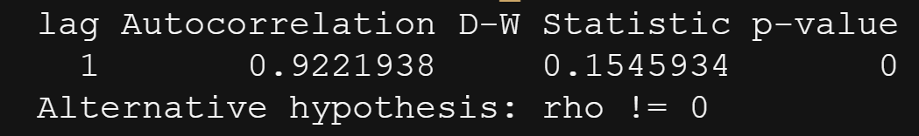
Evaluating the Linear Model
Homoscedasticity?
Looking at scatterplot, variance increases with larger fitted values
Corresponds to higher volatility
Uncorrelated Errors?
Model has an autocorrelation of ~0.92
Durbin-Watson hypothesis firmly rejected for model

Slide 12
Time Series Modeling

Slide 13
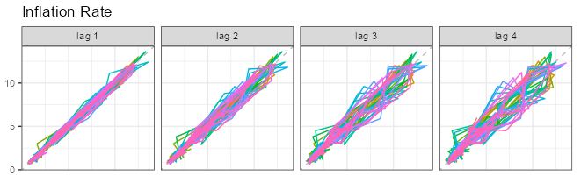
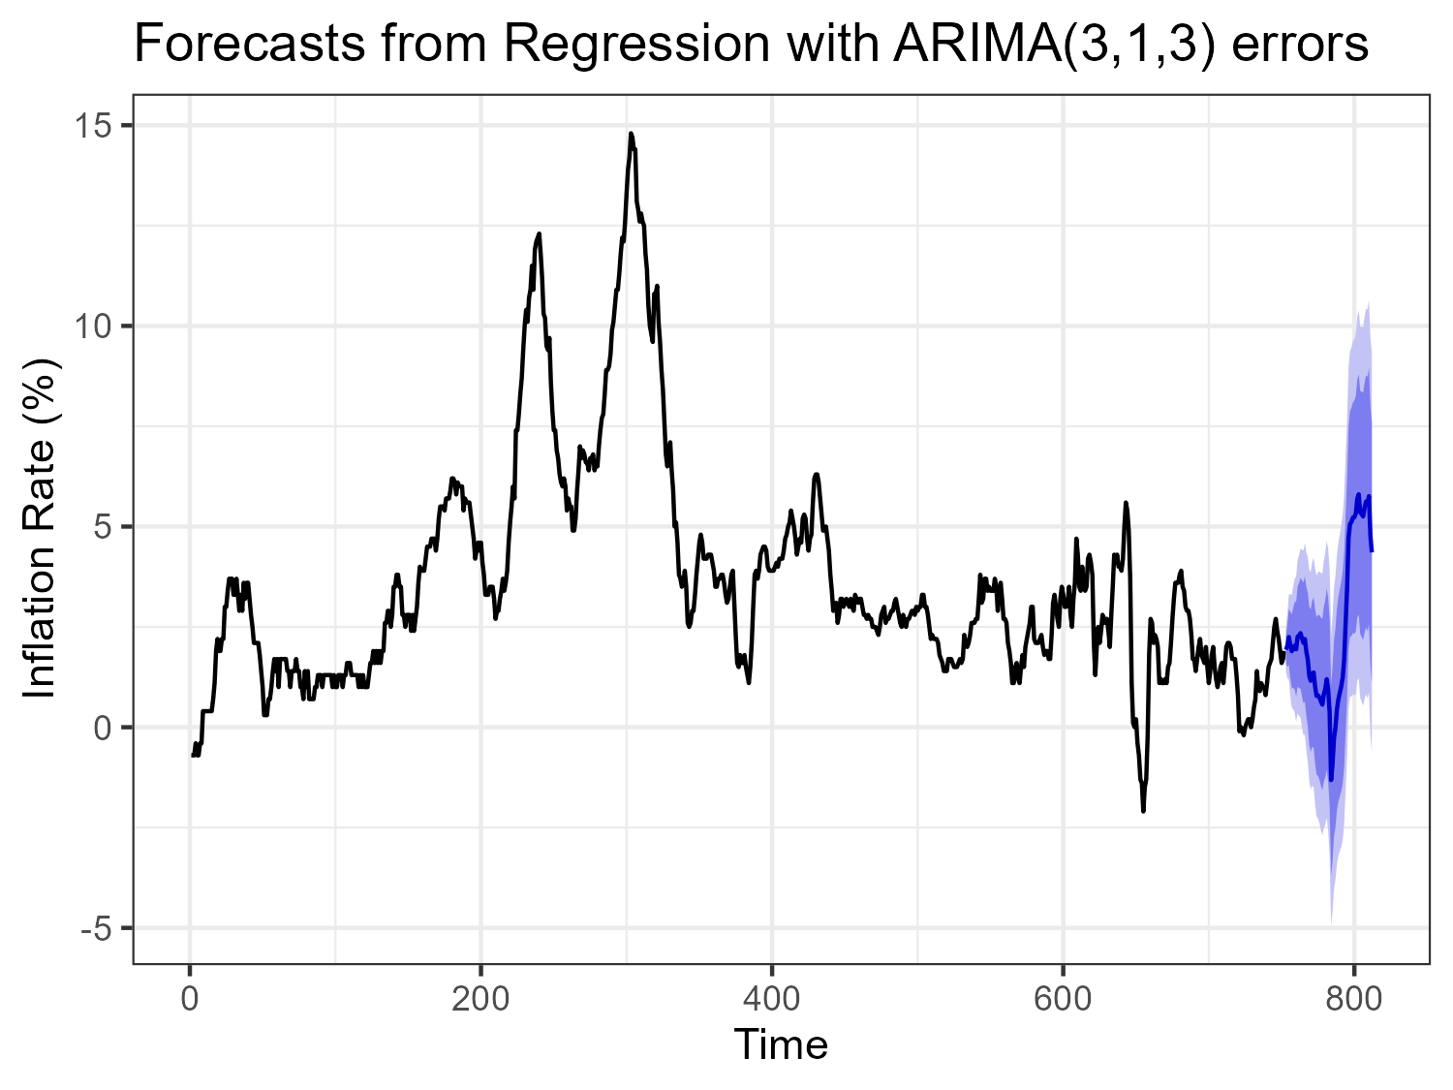
How can we model this data better?
Include autocorrelation into model predictions
ARIMA models are made for data with autocorrelations
Tested a model with only autoregression and dynamic models including regressors
Evaluate based on prediction error from 5-year forecast
Best Results
MAE: 0.948%
MedAE: 0.626%
Max Error: 3.94%
AIC: 212.99
BIC: 273.06
Notes:
- Explain that MedAE means Median Absolute Error

Slide 14
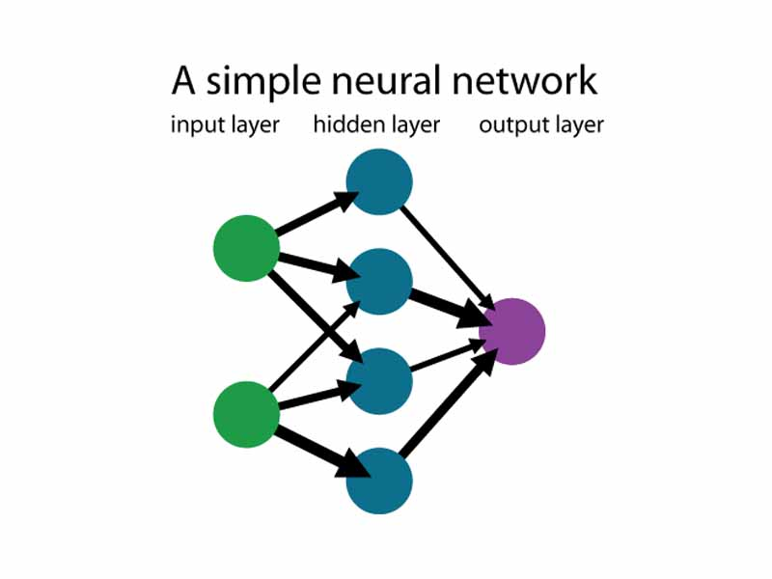
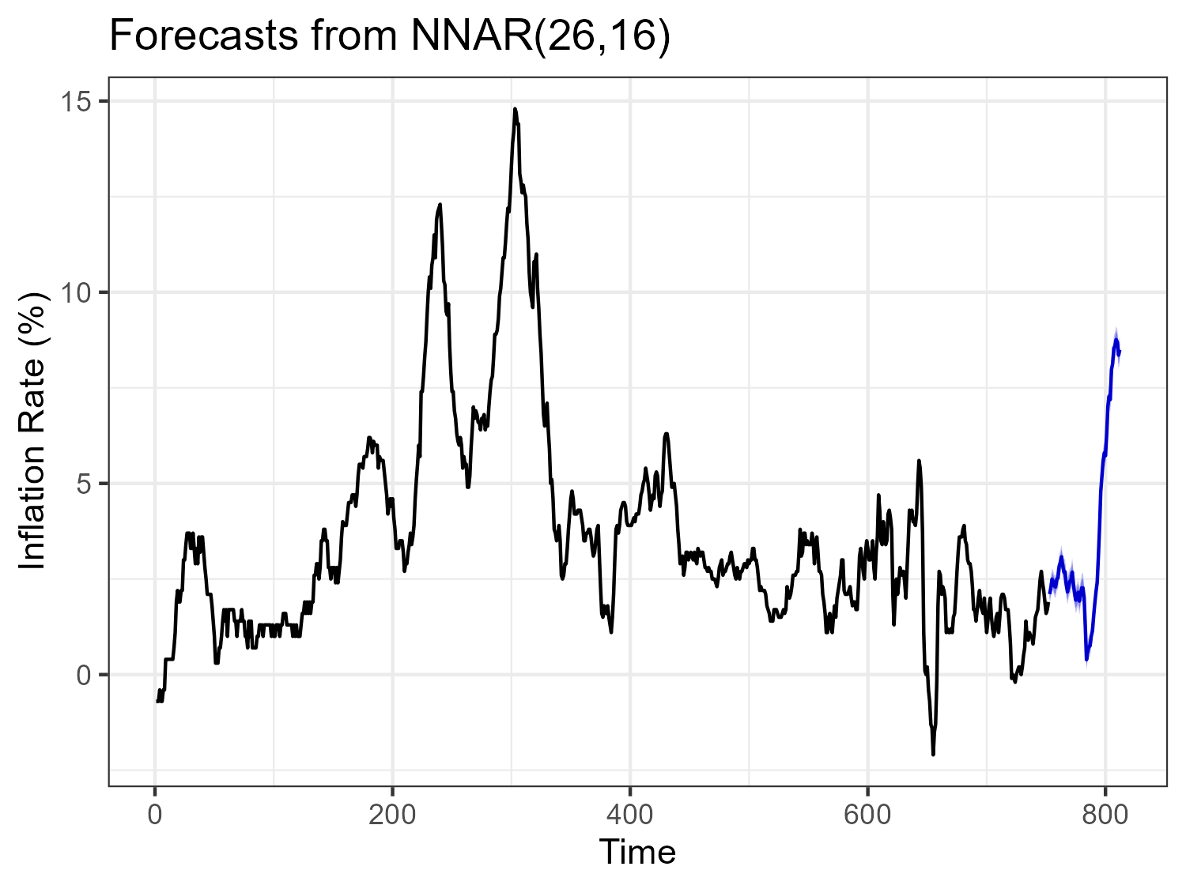
Another Approach: Neural Networks
Neural networks are better at understanding complex non-linear relationships
NNAR model incorporates autoregression
Same testing and evaluation criteria as ARIMA
Best Results
MAE: 0.406%
MedAE: 0.311%
Max Error: 1.33%

Slide 15
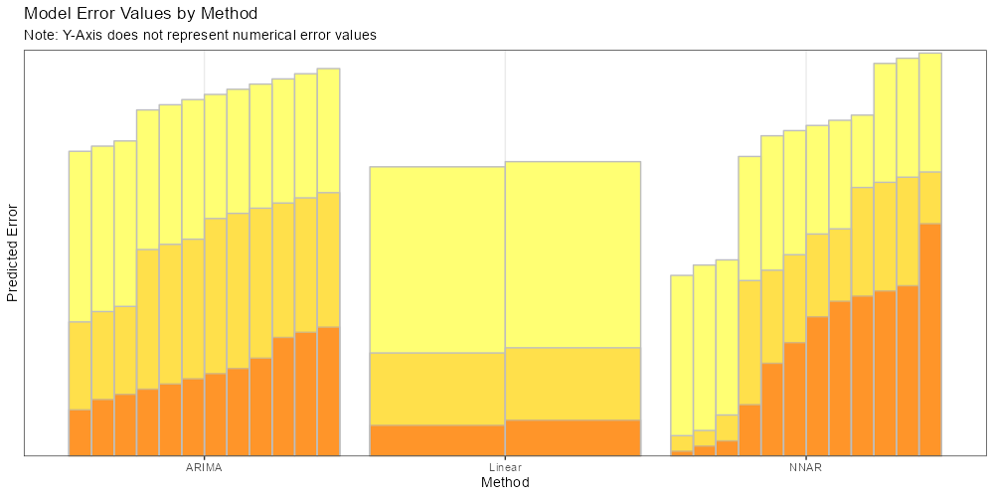
Time Series Model Evaluation
Tested 26 models in total
2 Linear Models
12 ARIMA Models
12 NNAR Models
Evaluated based on
Predicted MAE
Predicted Median AE
Predicted Max Error
AIC (Linear and ARIMA)
BIC (Linear and ARIMA)
ARIMA models had consistently decent performance
Linear models had good MAEs and Median AEs, but high max errors
NNAR models had varied performance but top models did the best overall

Slide 16
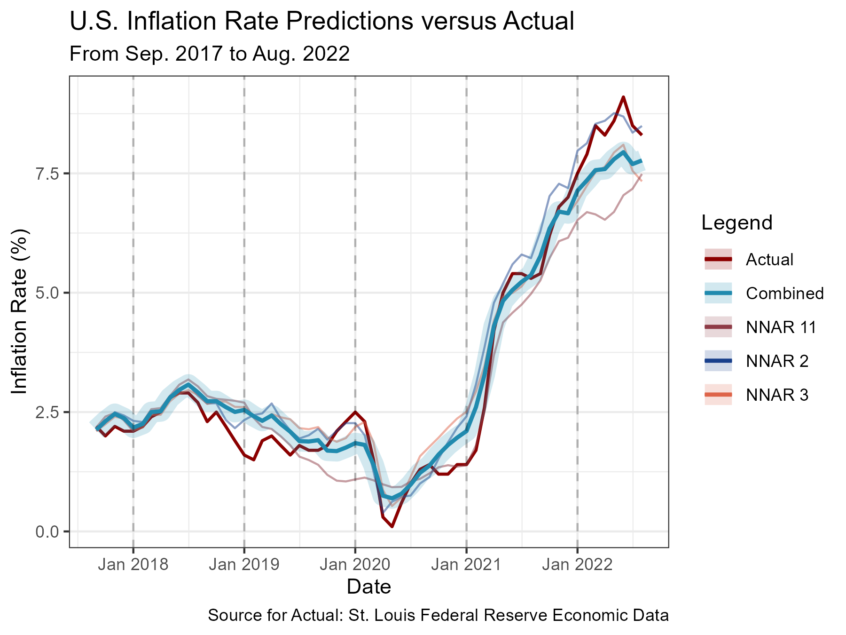
Final Model Selection
Selected Models:
NNAR with all regressors (NNAR 2)
NNAR with all except oil prices (NNAR 3)
NNAR using only commodity prices (NNAR 11)
Combined model averages predictions of our three selected models
MAE: 0.349, Max Error: 0.944
Notes:
Combined Results Stats - MAE: 0.346%, MedAE: 0.289%, Max Error: 0.944%

Slide 17
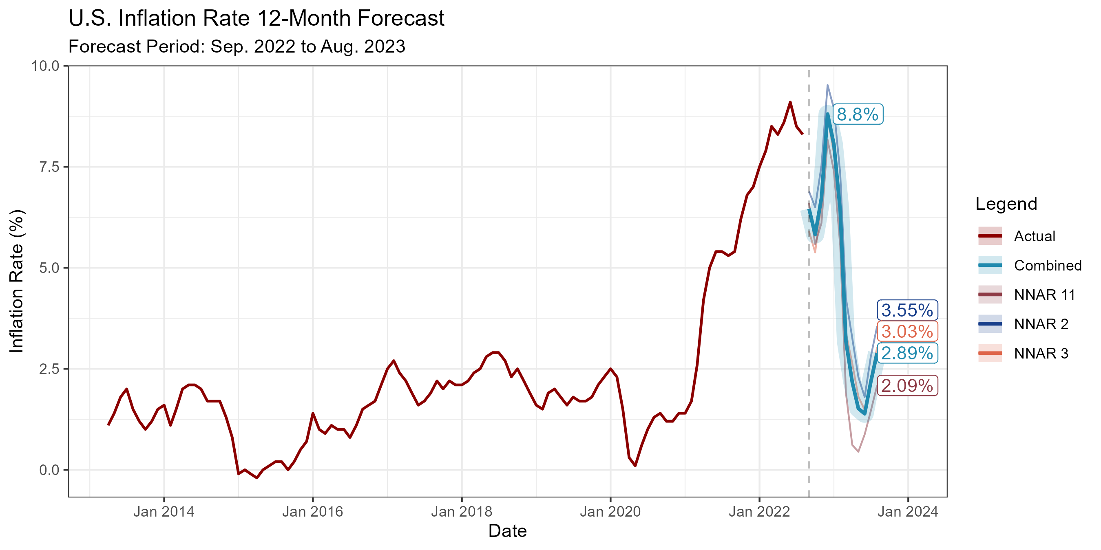
12-Month Inflation Forecast
Finally, we can forecast inflation into the future
Requires forecasting regressors as well
August 2023 Projections:
NNAR 2: 3.55%
NNAR 3: 3.03%
NNAR 11: 2.09%
Combined Model: 2.89%
All models expect inflation to drop significantly by March 2023

Slide 18

Conclusions
Inflation is expected to drop substantially through 2023
Commodity prices are especially useful for predicting inflation but tend to underestimate
Consumer sentiment drops in times of volatile inflation

Slide 19
Questions

Slide 20
Appendix 1 – Data Cleaning Summary
Transformed most variables to be 12-month percent changes
Some data was originally in a wide format, so it needed to be transformed to a long format
Consumer Sentiment data featured a lot of missing data before 1978, so this was imputed using linear interpolation
No other variables were missing data
Dates separated into month and year columns
Finally, data was combined into one data frame
Log-transforming the data was tried, however it did not improve model performance

Slide 21
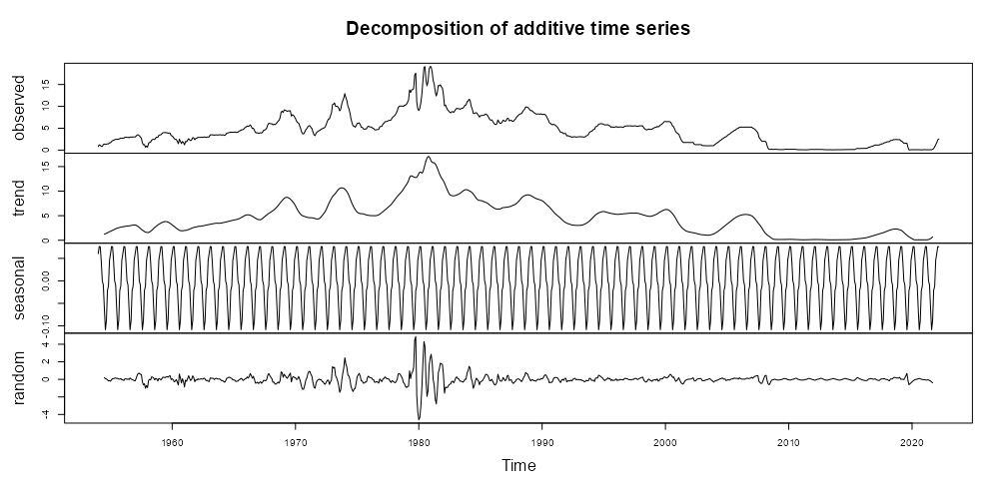
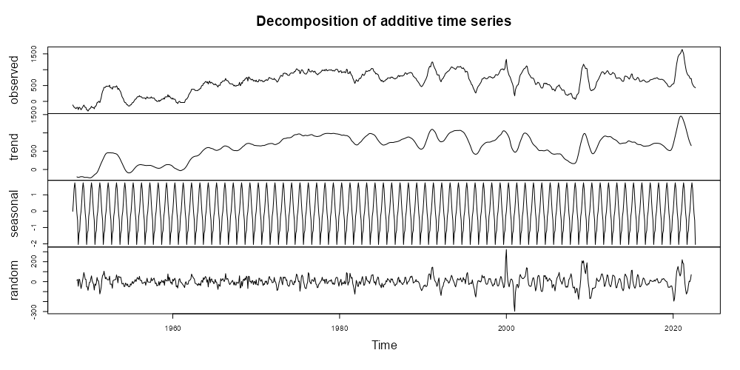
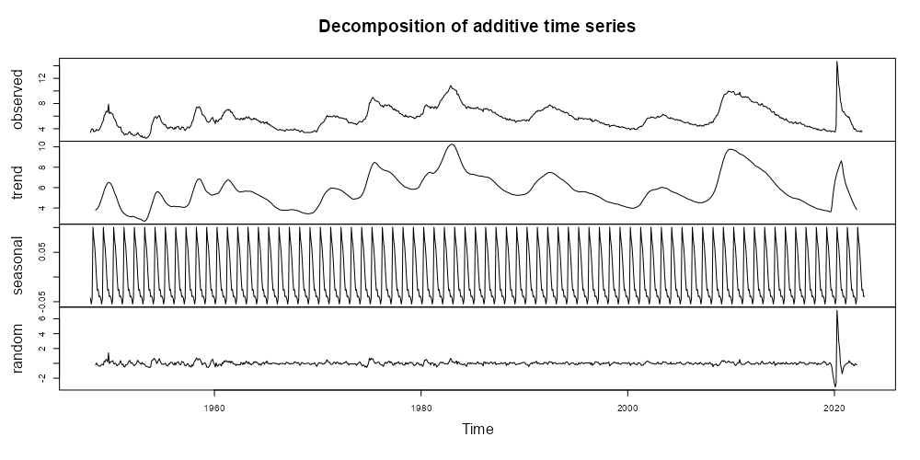
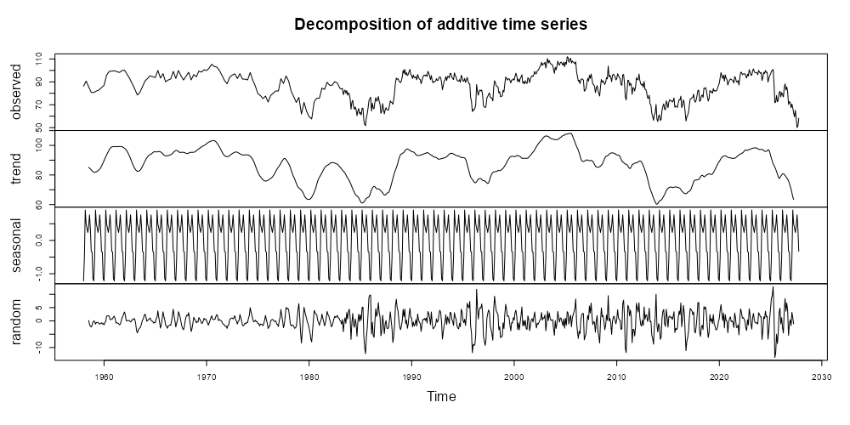
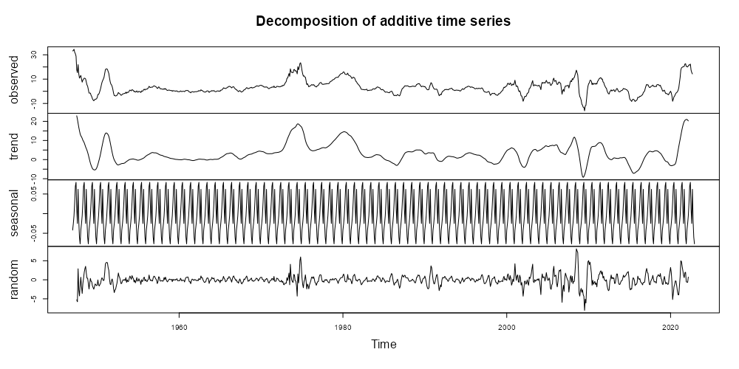
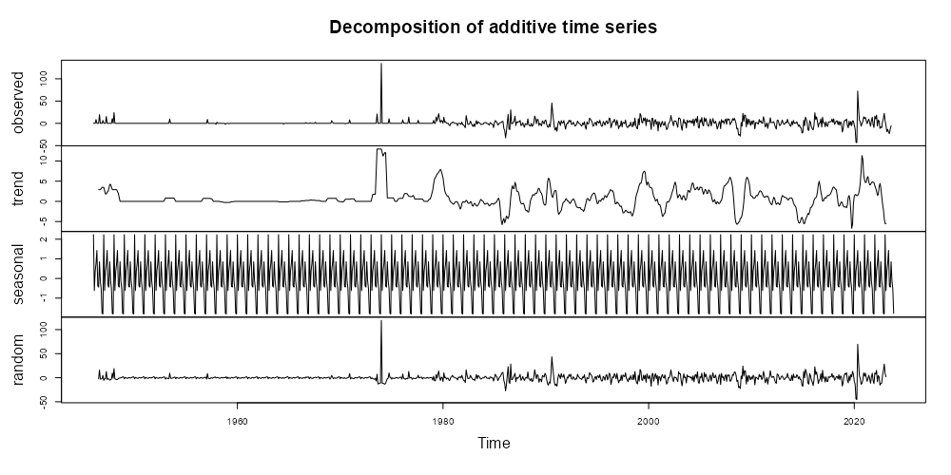
Appendix 2a – Time Series Decompositions
Federal Funds
Money Supply
Unemployment
Consumer Sentiment
Commodities Price Index
Oil Price Index

Slide 22
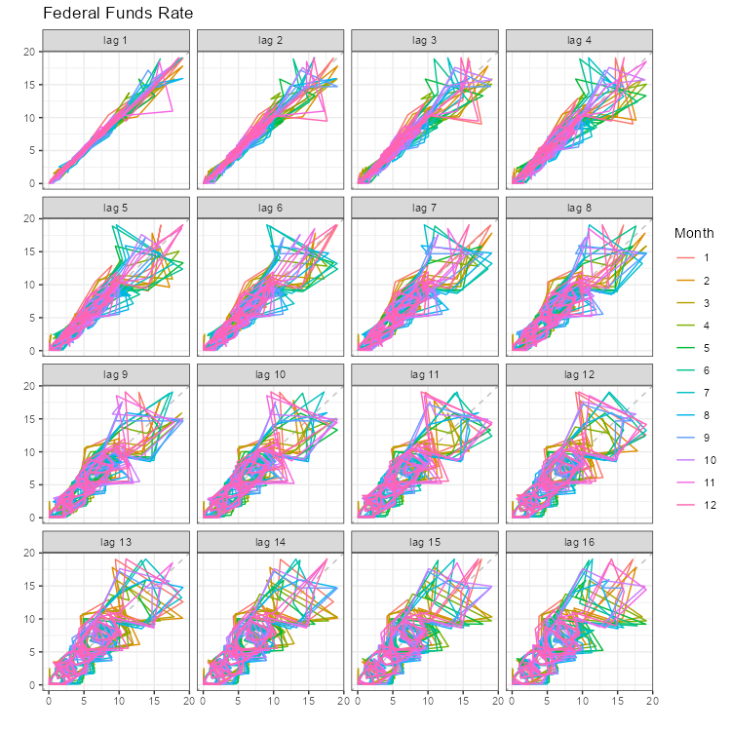
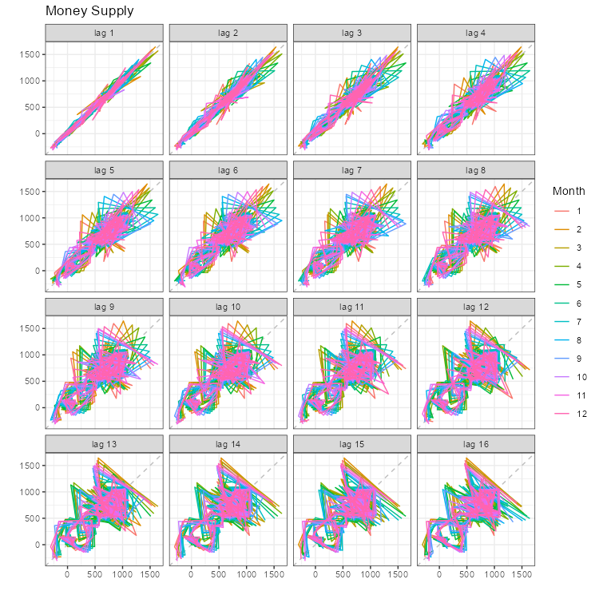
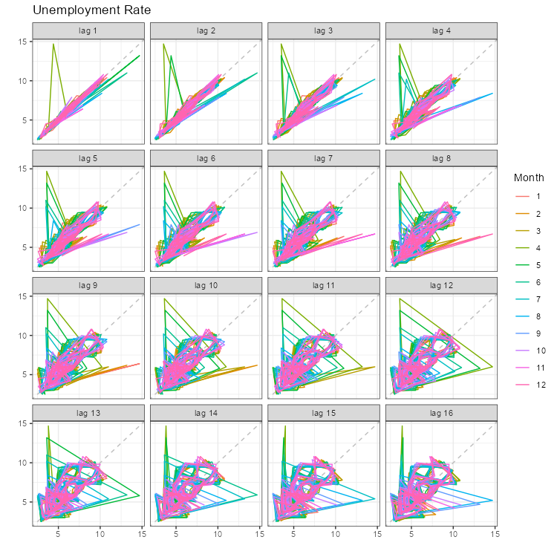
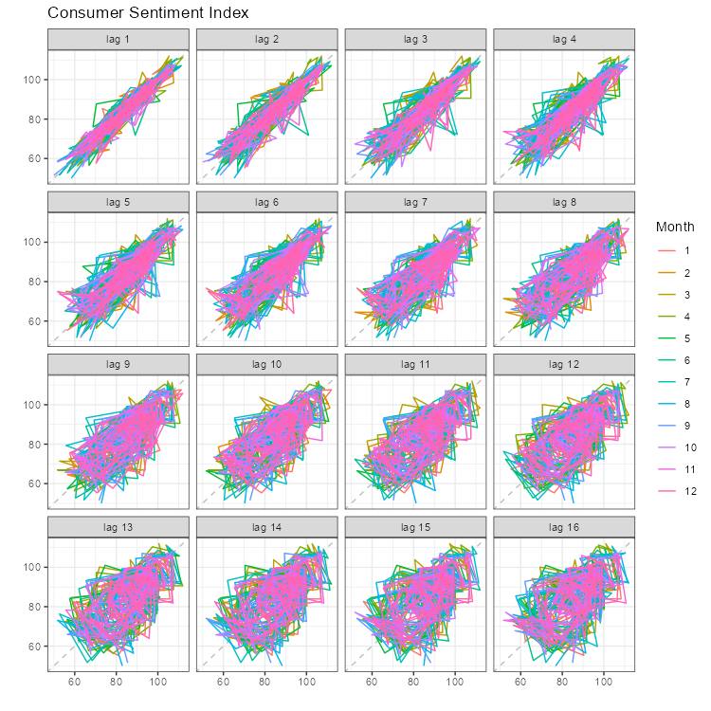
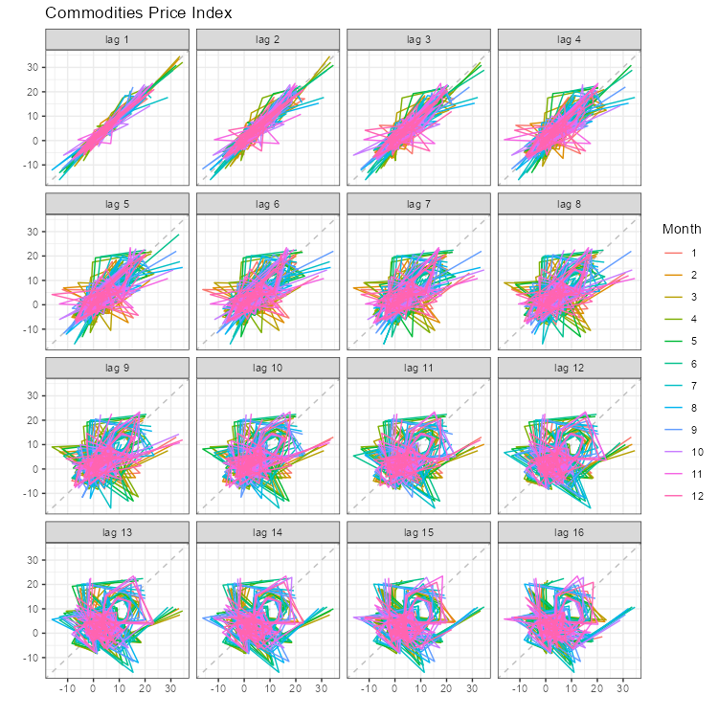
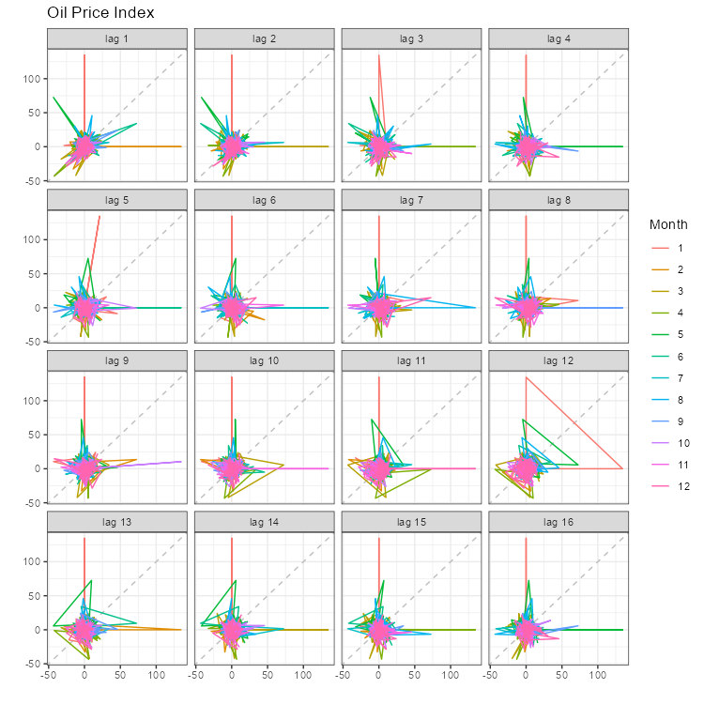
Appendix 2b – Lag Plots

Slide 23
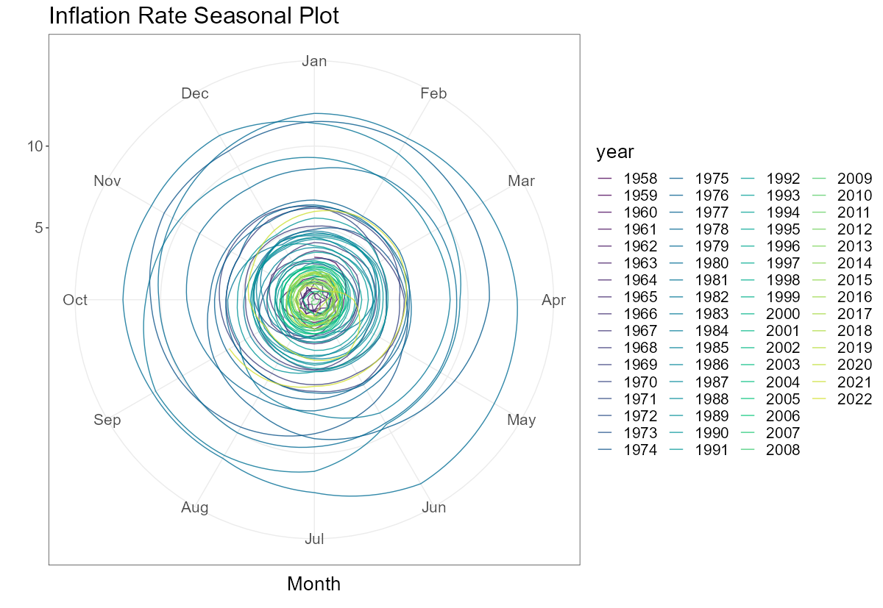
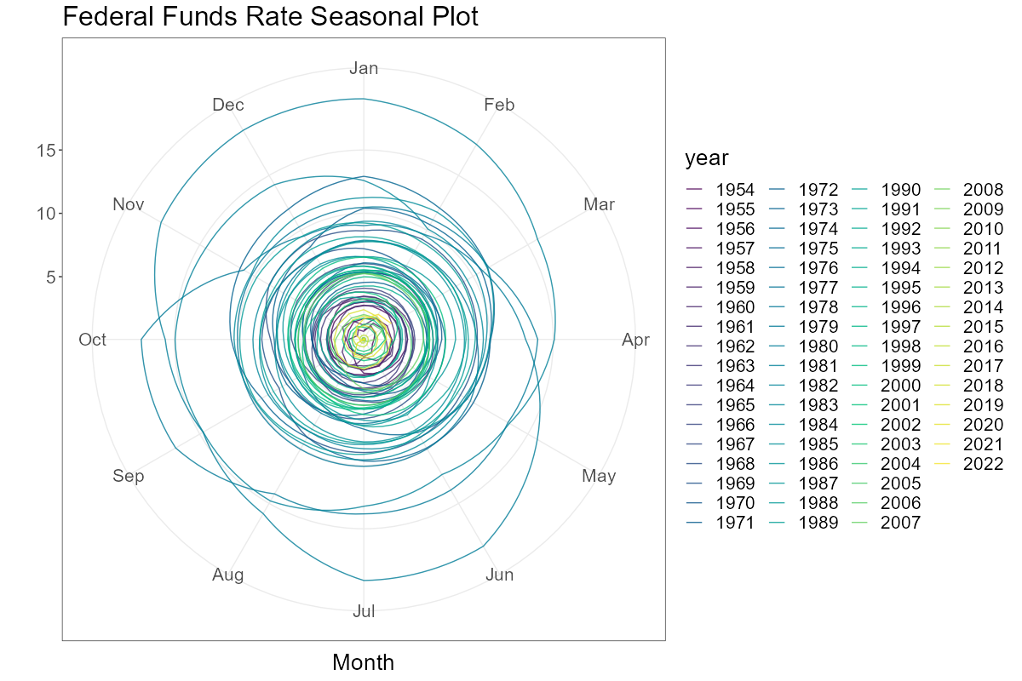
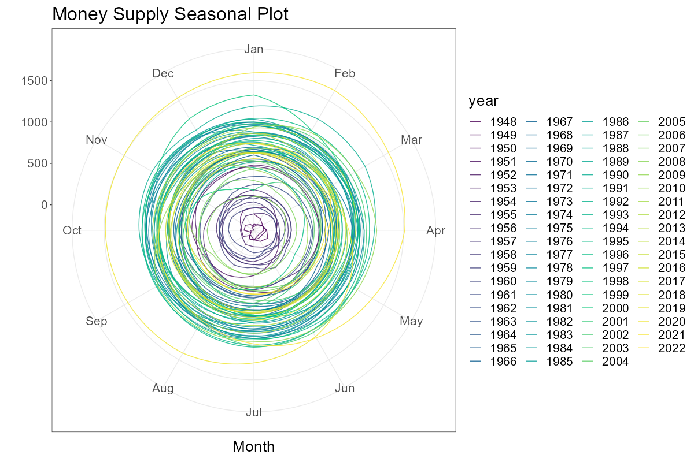
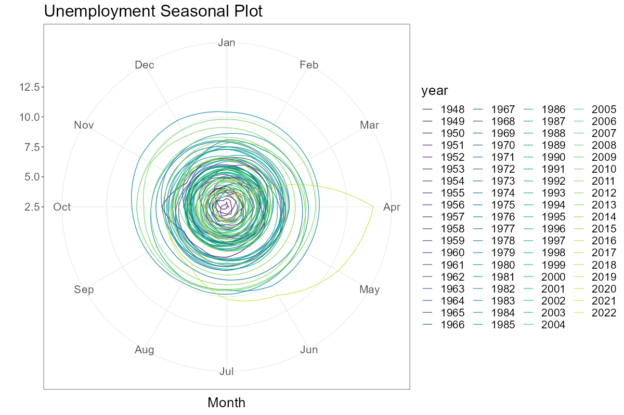
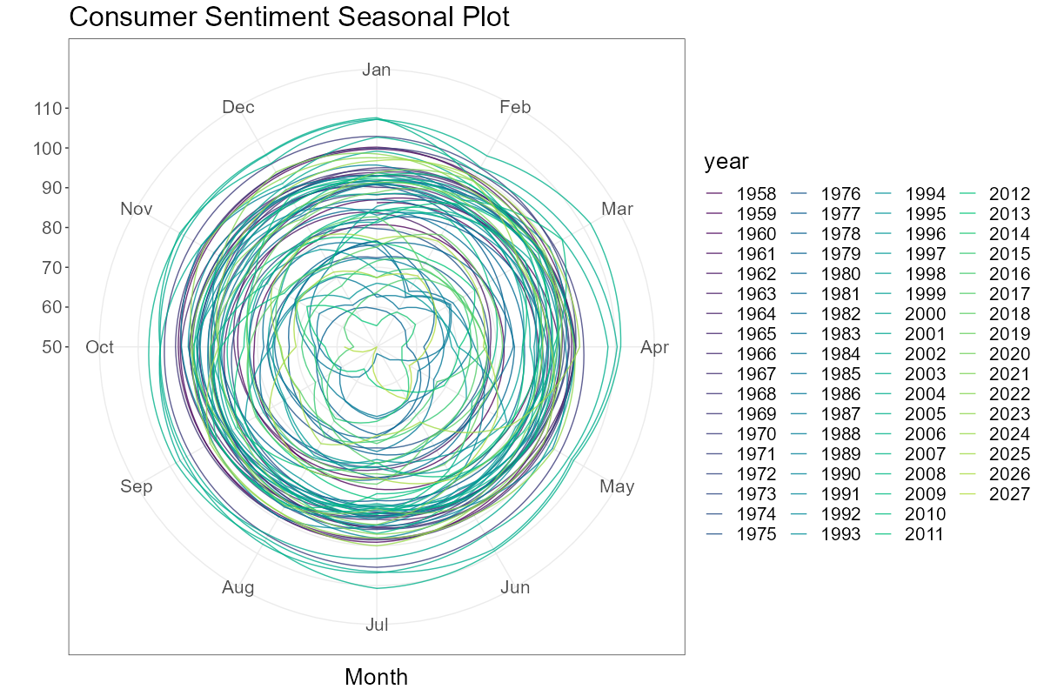
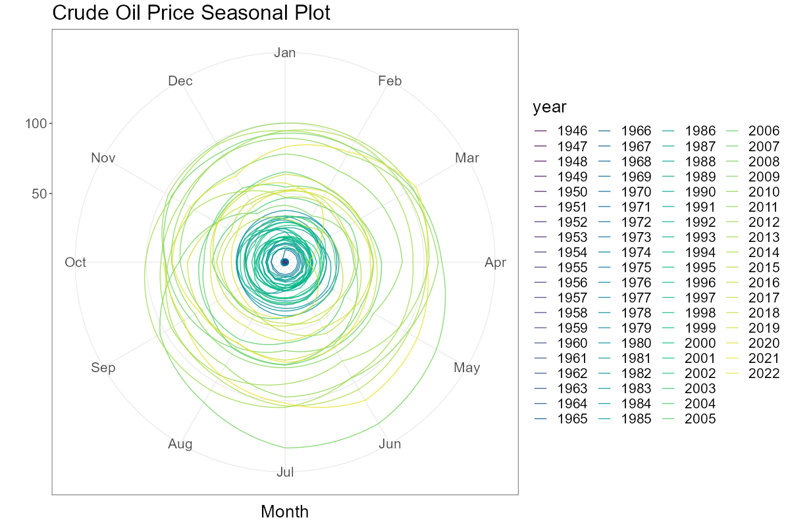
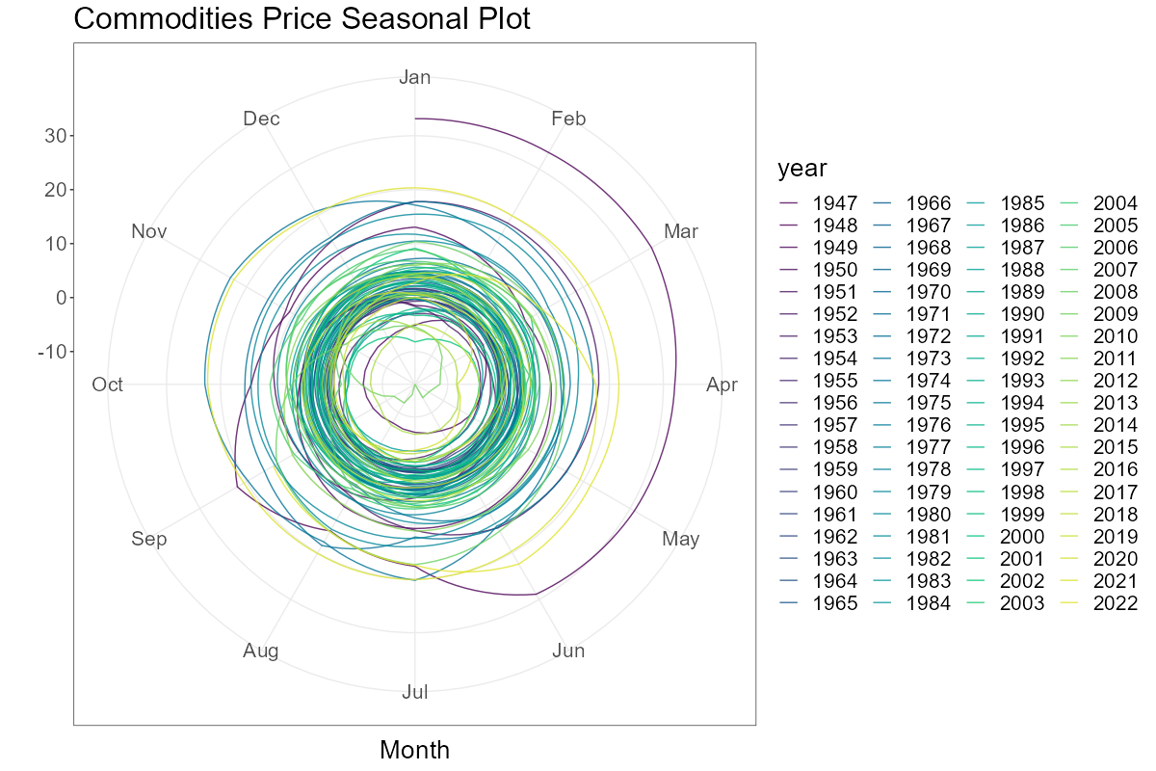
Appendix 2c – Season Plots

Slide 24
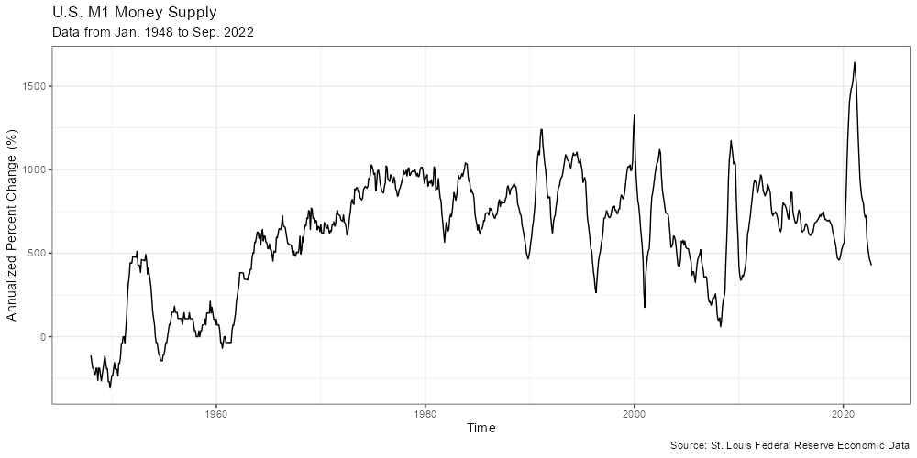
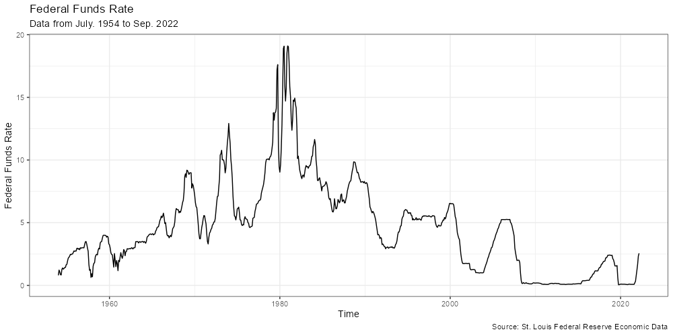
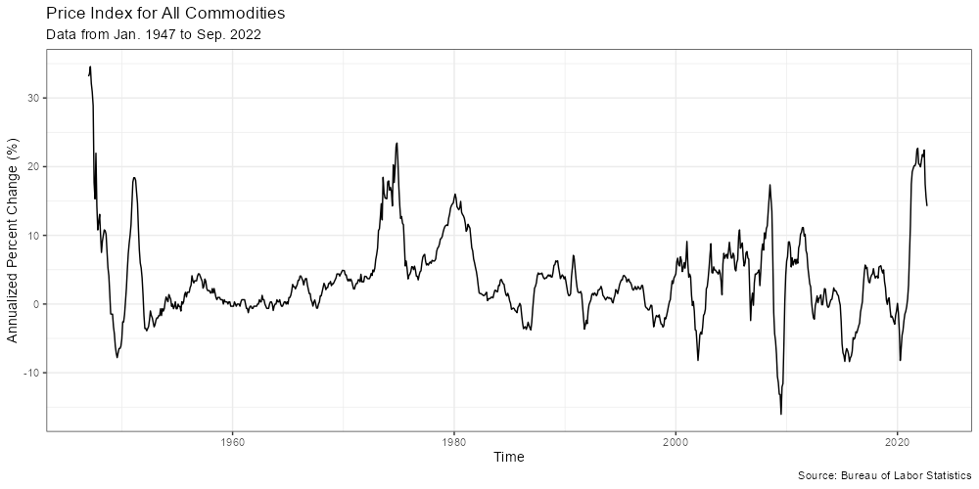
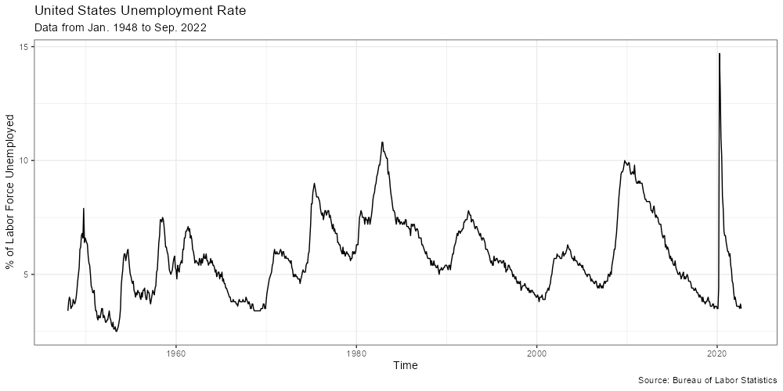
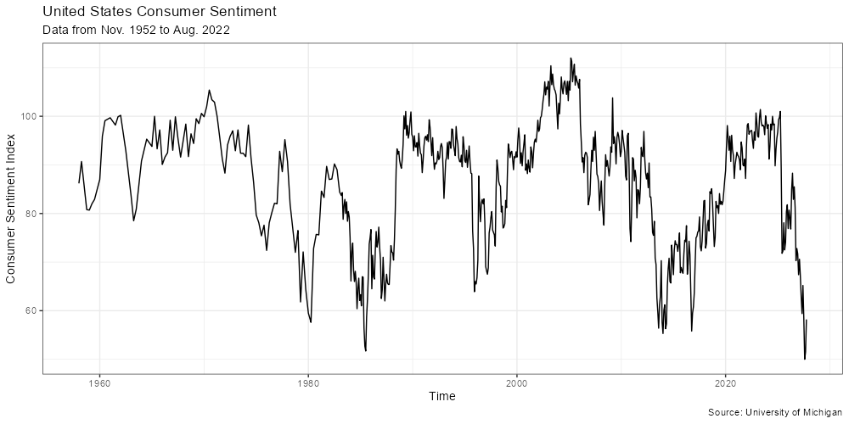
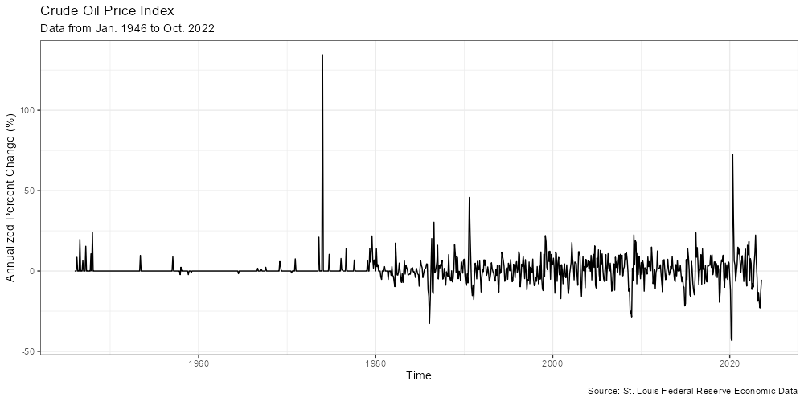
Appendix 3 – Line plots of variables

Slide 25
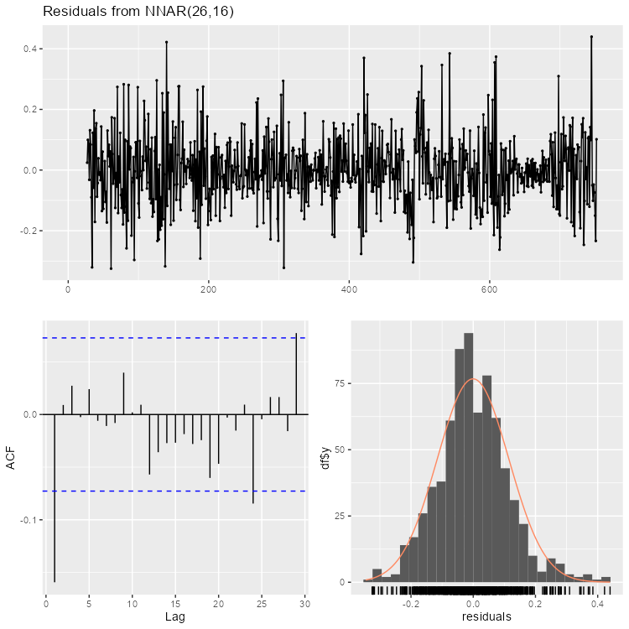
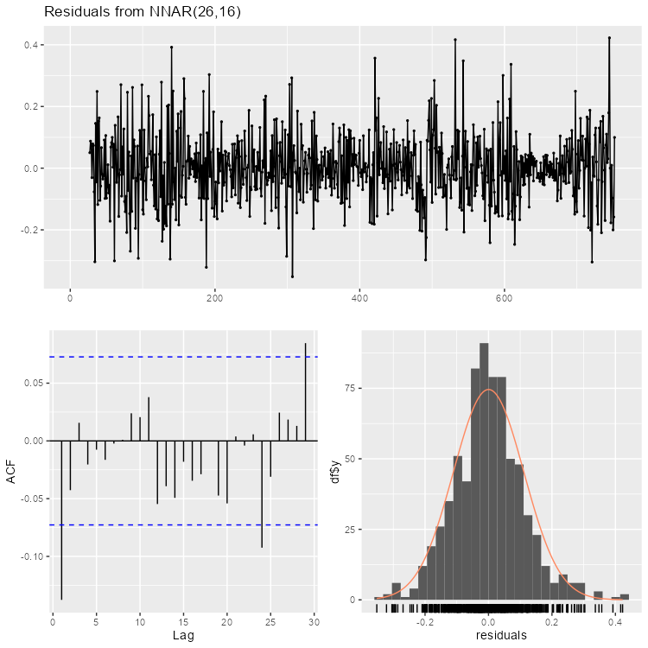
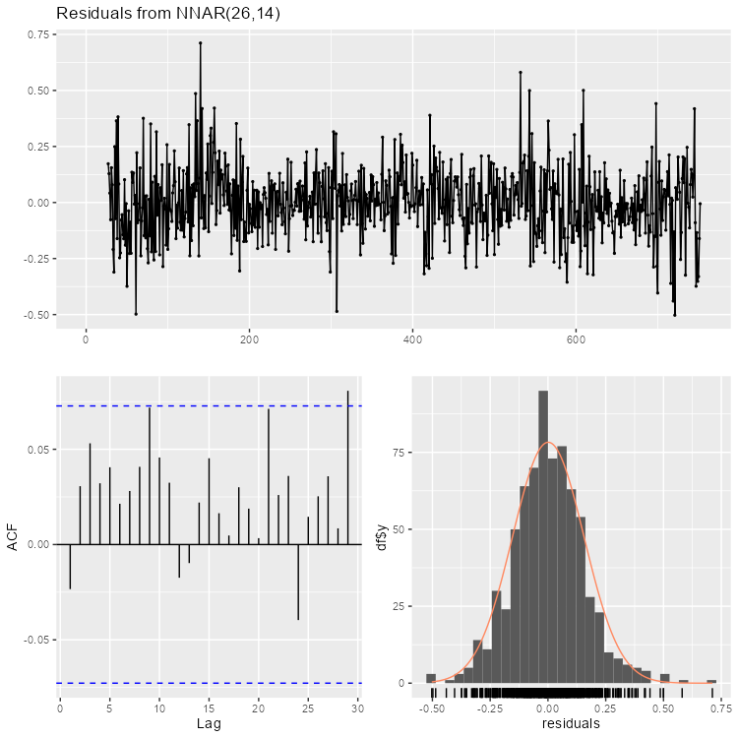
Appendix 4 – Residual Plots
NNAR 2
NNAR 3
NNAR 11

Slide 26

Appendix 5 – Full Pair Plot
Note:
Oil price and commodities were mislabeled and should be switched

Slide 27
Appendix 6 – Modeling Methodology
Linear model
Full model first tested
Stepwise regression used which removed commodities index, but performance did not dramatically improve
ARIMA model
Model using only autoregression tested
Next, models using only one of the regressors were tested
Finally, a few combinations of regressors were tested
NNAR model
Same combinations of regressors as specified for ARIMA models
Combination model
Outside research has shown that averaging predictions from various models can improve predictions
3 of the NNAR models were distinctly better than the rest, so these were averaged

Slide 28
Appendix 7 – Forecasting Methodology
Given that our models used other variables to forecast, we need to forecast these variables themselves
Quality of the inflation forecast is built on the quality of the other forecasts
Federal funds rate is estimated to be 4.5% in 2023, so forecast was a linear interpolation
Money supply, unemployment, and oil prices were forecasted similarly, but money supply and oil prices had 12-month percent changes calculated from linear interpolation
Consumer sentiment and commodities were forecasted using a NNAR model based on autoregression

Slide 29

Appendix 8 – Full Inflation Forecasts

Slide 30

Appendix 9 – Model Evaluation Results

